Slide 1


Slide 2


Slide 3


Slide 4


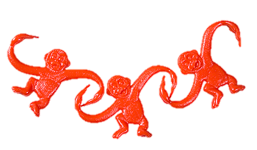
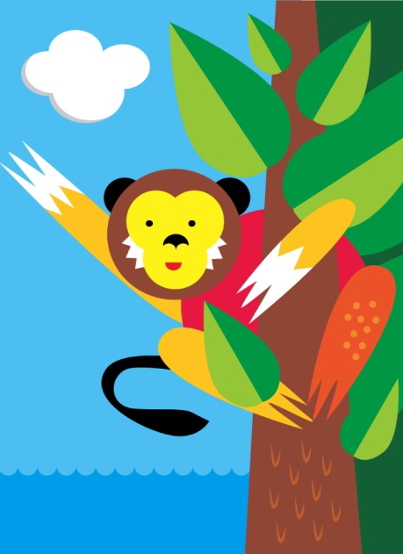
Evolution:
Funky Monkeys
An Interactive Lesson About Evolution and Natural Selection
© Getting Nerdy, LLC

Slide 5
Here’s what you’ll need to conduct this experiment:
Funky Monkey groups, Funky Monkey Paradise, Black & White Fortune Cookies, and the Pouch of Predestination
Before You Begin:
What is an adaptation?
Any physical or behavioral characteristic that helps an organism survive in its environment
What does it mean when an organism is extinct?
That species of organism no longer exists on earth
What does it mean when an organism is endangered?
That species of organism is at high risk of becoming extinct
© Getting Nerdy, LLC

Slide 6
Background Information: The Funky Monkey is a primate species that lives on Funky Island along the equator near Central America. There are three special traits within the monkey population on Funky Island: tail length, diet, and fur color.
Which Funky Monkey are YOU?
1: Long-tailed, herbivorous, brown furred funky monkey?
2: Tailless, carnivorous, brown furred funky monkey?
3: Tailless, herbivorous, blonde furred funky monkey?
4: Long-tailed, carnivorous, blonde furred funky monkey?
Circle the group to which you have been assigned!
Hypothesis: What environmental conditions do you think will be beneficial to your survival based on your traits?
© Getting Nerdy, LLC

Slide 7
What You Do:
Count off by 5’s and each student will begin as a funky monkey (1-4) or an “angel” in paradise (5).
The Wrath of Nature (your teacher) will roll a 12 sided die that leads to one of 12 slides within the PowerPoint. Each slide affects one or more of the funky monkey populations.
If the environmental condition affects YOUR population, each member of that population must choose a “Fortune Cookie” from the “Pouch of Predestination” to determine whether you LIVE or DIE, REPRODUCE or STAY CHILDLESS.
LIVE and you stay with your funky monkey clan; DIE and you must go to funky monkey paradise in a most dramatic way. In order to REPRODUCE, you and another funky monkey from your clan must pull a white chip - choose an “angel” from paradise; STAY CHILDLESS and you continue to live life as a lonely monkey.
BLACK CHIP = DIE or STAY CHILDLESS
WHITE CHIP = LIVE or REPRODUCE
© Getting Nerdy, LLC

Slide 8
The Results: What Happened?
Look around - how many funky monkeys are in each group as you begin this activity?
Fill in the chart on your paper
Monkey Type | Initial Numbers | Final Numbers
Long-tailed, herbivorous, brown furred
Tailless, carnivorous, brown furred
Tailless, herbivorous, blonde furred
Long-tailed, carnivorous, blonde furred
© Getting Nerdy, LLC

Slide 9
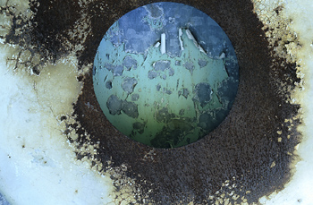
Are you ready for the wrath of nature?
© Getting Nerdy, LLC

Slide 10


1
A volcano erupts spreading ash and spilling lava. The Banananana trees have all burned down. Long-tailed monkeys have lost their home. If you are a group with long tails, each monkey will choose a fortune cookie from the pouch of predestination. If it is black, you die and go to paradise. If it is white, you live and stay with your group.
© Getting Nerdy, LLC

Slide 11

2
Tailless funky monkeys are better able to show off their bright red butts to the opposite sex. If you are in a funky monkey group without tails, choose a fortune cookie from the pouch of predestination to see if you reproduce. If you choose white, you have a baby- pick an “angel” from paradise. Choose black, and you remain childless.
© Getting Nerdy, LLC

Slide 12

3
dirty gerdy smelly mellie gnllc
The once protected Funky Monkey island has lifted the hunting ban on Funky Monkeys. Brown furred Funky Monkeys are much more difficult to find against the brown and green vegetation. If you are blonde furred, choose a chip. If it is black, you die.
© Getting Nerdy, LLC

Slide 13

4
Humans have begun training Funky Elephants using bananas from the beloved Banananana Tree. The elephants love them so much now that they have begun eating them in the wild and there aren’t enough bananas for the monkeys. If you are an herbivorous, long-tailed Funky Monkey, choose a fortune cookie from the pouch of predestination. If it is black, you die and go to paradise. If it is white, you live.
© Getting Nerdy, LLC

Slide 14

5
Carnivorous Funky Monkeys have found that their favorite treat, the Boogley-eyed frog, had a population explosion due to an increase in flies. Carnivorous monkeys rejoice! If carnivorous, choose a chip. If it is white, you reproduce.
© Getting Nerdy, LLC

Slide 15
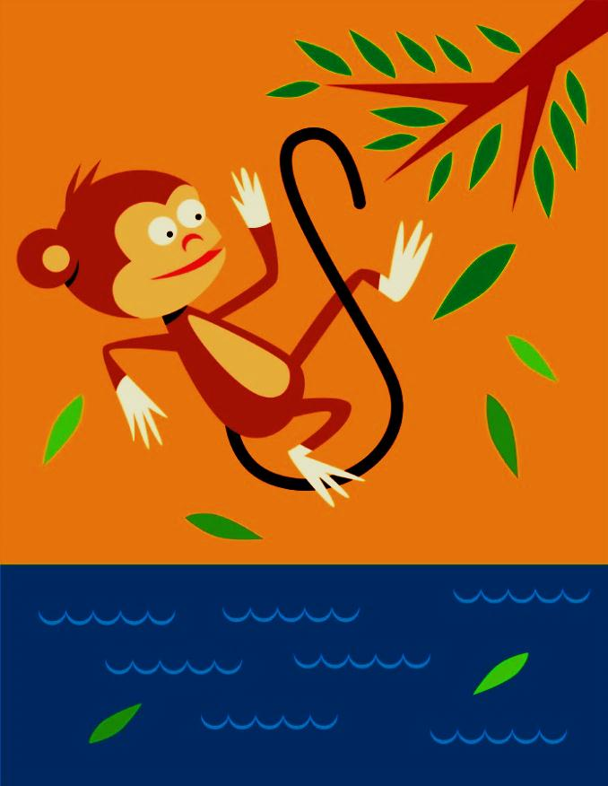
6
A drought comes and destroys the fragile banananana trees. Tailless Funky Monkeys are better adapted to eat berries from the low lying bungabunga bush. If Tailless and herbivorous, choose a chip. If it is white, you reproduce.
© Getting Nerdy, LLC

Slide 16

7
The bananas on the banananana tree contain a lot of potassium. This prevents muscle cramps in the very hyper herbivorous, long-tailed Funky Monkeys. If herbivorous AND long-tailed, choose a chip. If it is white, you reproduce.
© Getting Nerdy, LLC

Slide 17
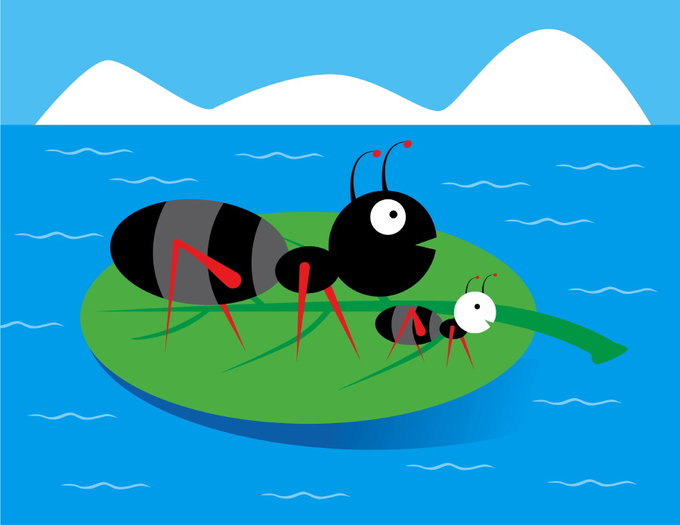
8
A disease carrying ant colony arrives at Funky Island. The disease affects EVERY group of Funky Monkeys. Choose a chip. If it is black, you die.
© Getting Nerdy, LLC

Slide 18


9
Do Not Feed the Monkeys
Ecotourism has taken off and humans have begun visiting Funky Island in droves. They never pay attention to the “Do Not Feed” signs and now the herbivorous monkeys are getting over fed and populations soar. If you are an herbivorous Funky Monkey, choose a chip. If it’s white you reproduce.
© Getting Nerdy, LLC

Slide 19
10
Alternating days of sun and rain means TONS of vegetative growth. Long-tailed, herbivorous Funky Monkeys are better able to feed their young because the banananana tree is flourishing. If long-tailed AND herbivorous, choose a chip. If it is white, you reproduce.
© Getting Nerdy, LLC

Slide 20


11
Bungabunga bushes are busy reproducing this spring. The winds pick up and blow their pollen into the Funky Monkey population. The fair skinned Blonde furred population has sever allergies and their population dwindles. If you are a blonde furred Funky Monkey, pick a chip. If it is black you die.
© Getting Nerdy, LLC

Slide 21
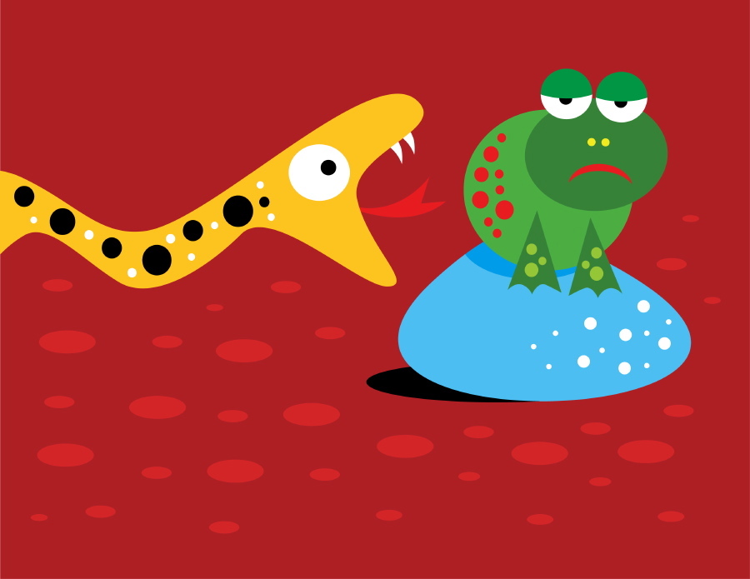
12
The once populous Boogley-eyed frogs have died due to a new species of snake that inhabits the island. Tailless, carnivorous Funky Monkeys have nothing to eat. Luckily the long-tailed carnivores are enjoying the Slimy-footed cousin of the Boogley-eyed frog. If you are tailless AND carnivorous, pick a chip. If it is black, you die.
© Getting Nerdy, LLC

Slide 22
The Results: What Happened?
Stay with your Funky Monkey group or in Funky Monkey Paradise and let’s tally our results. How many individuals remain in each funky monkey group?
Use the above information to answer the questions on your sheet.
Monkey Type | Initial Numbers | Final Numbers
Long-tailed, herbivorous, brown furred
Tailless, carnivorous, brown furred
Tailless, herbivorous, blonde furred
Long-tailed, carnivorous, blonde furred
© Getting Nerdy, LLC

Slide 23
The Results: What Happened?
Create a Double Bar Graph with the information from your chart. Be sure to label your X and Y axis, provide a title for your graph, and label your data. Use this data to answer the questions that follow.
© Getting Nerdy, LLC

Slide 24
The Results: What Happened?
What traits are present in the current Funky Monkey population? Is there the same variety as the beginning of the activity?
Compare the data from your graph on the previous page. Which, if any, of the Funky Monkey groups are ENDANGERED? How did you determine this?
Which, if any, of the Funky Monkey groups became EXTINCT?
Why do you think certain groups were more susceptible to endangerment and/or extinction?
© Getting Nerdy, LLC

Slide 25
The Results: What Happened? (continued…)
Which characteristics have become more plentiful in the Funky Monkey population? Why do you think those characteristics have become so abundant?
Basing your hypothesis on our current environmental conditions, what do you think the Funky Monkey population will look if we roll the dice another 30 times?
In this activity, how does adaptation affect the survival of the funky monkeys?
Pick an “endangered” group from the population. What kind of environmental change might benefit this group, causing them to become more populous?
Draw what this new environment will look like in the space on your paper.
© Getting Nerdy, LLC

